Slide 1
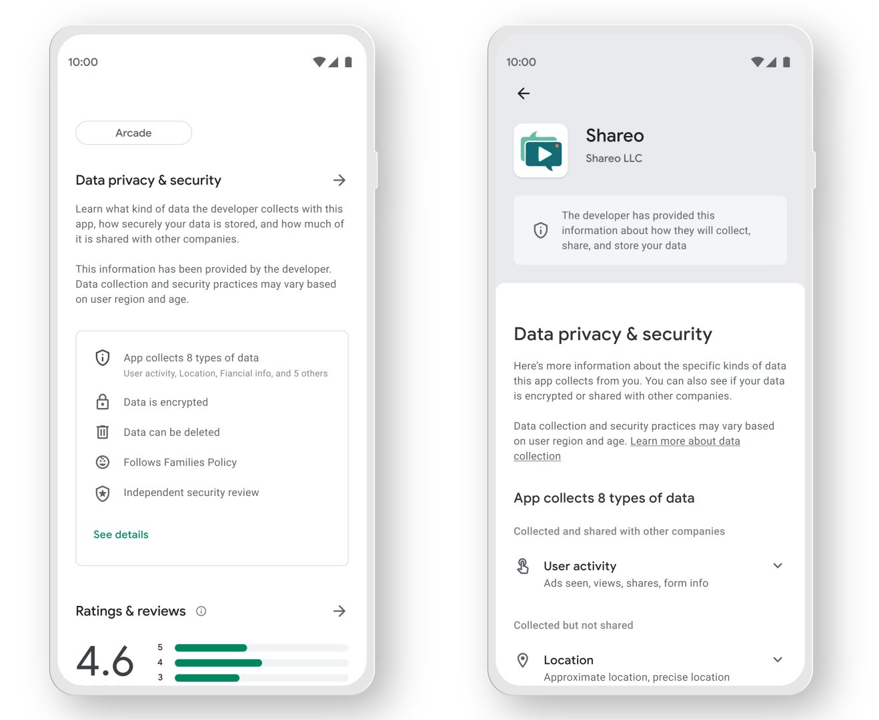
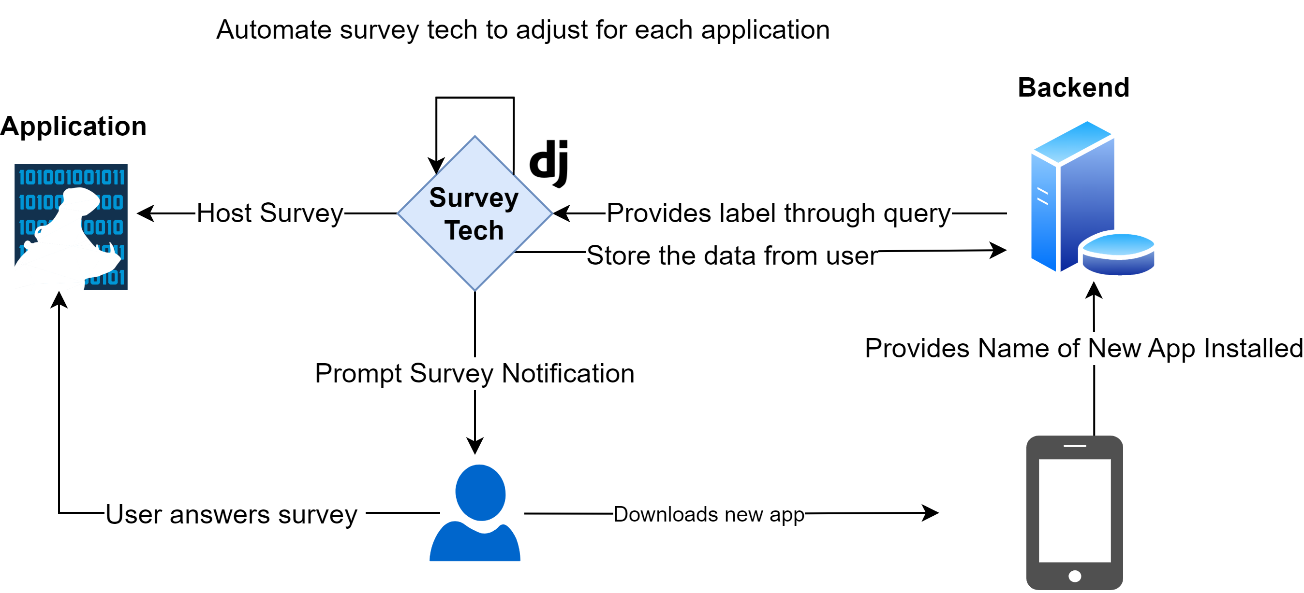

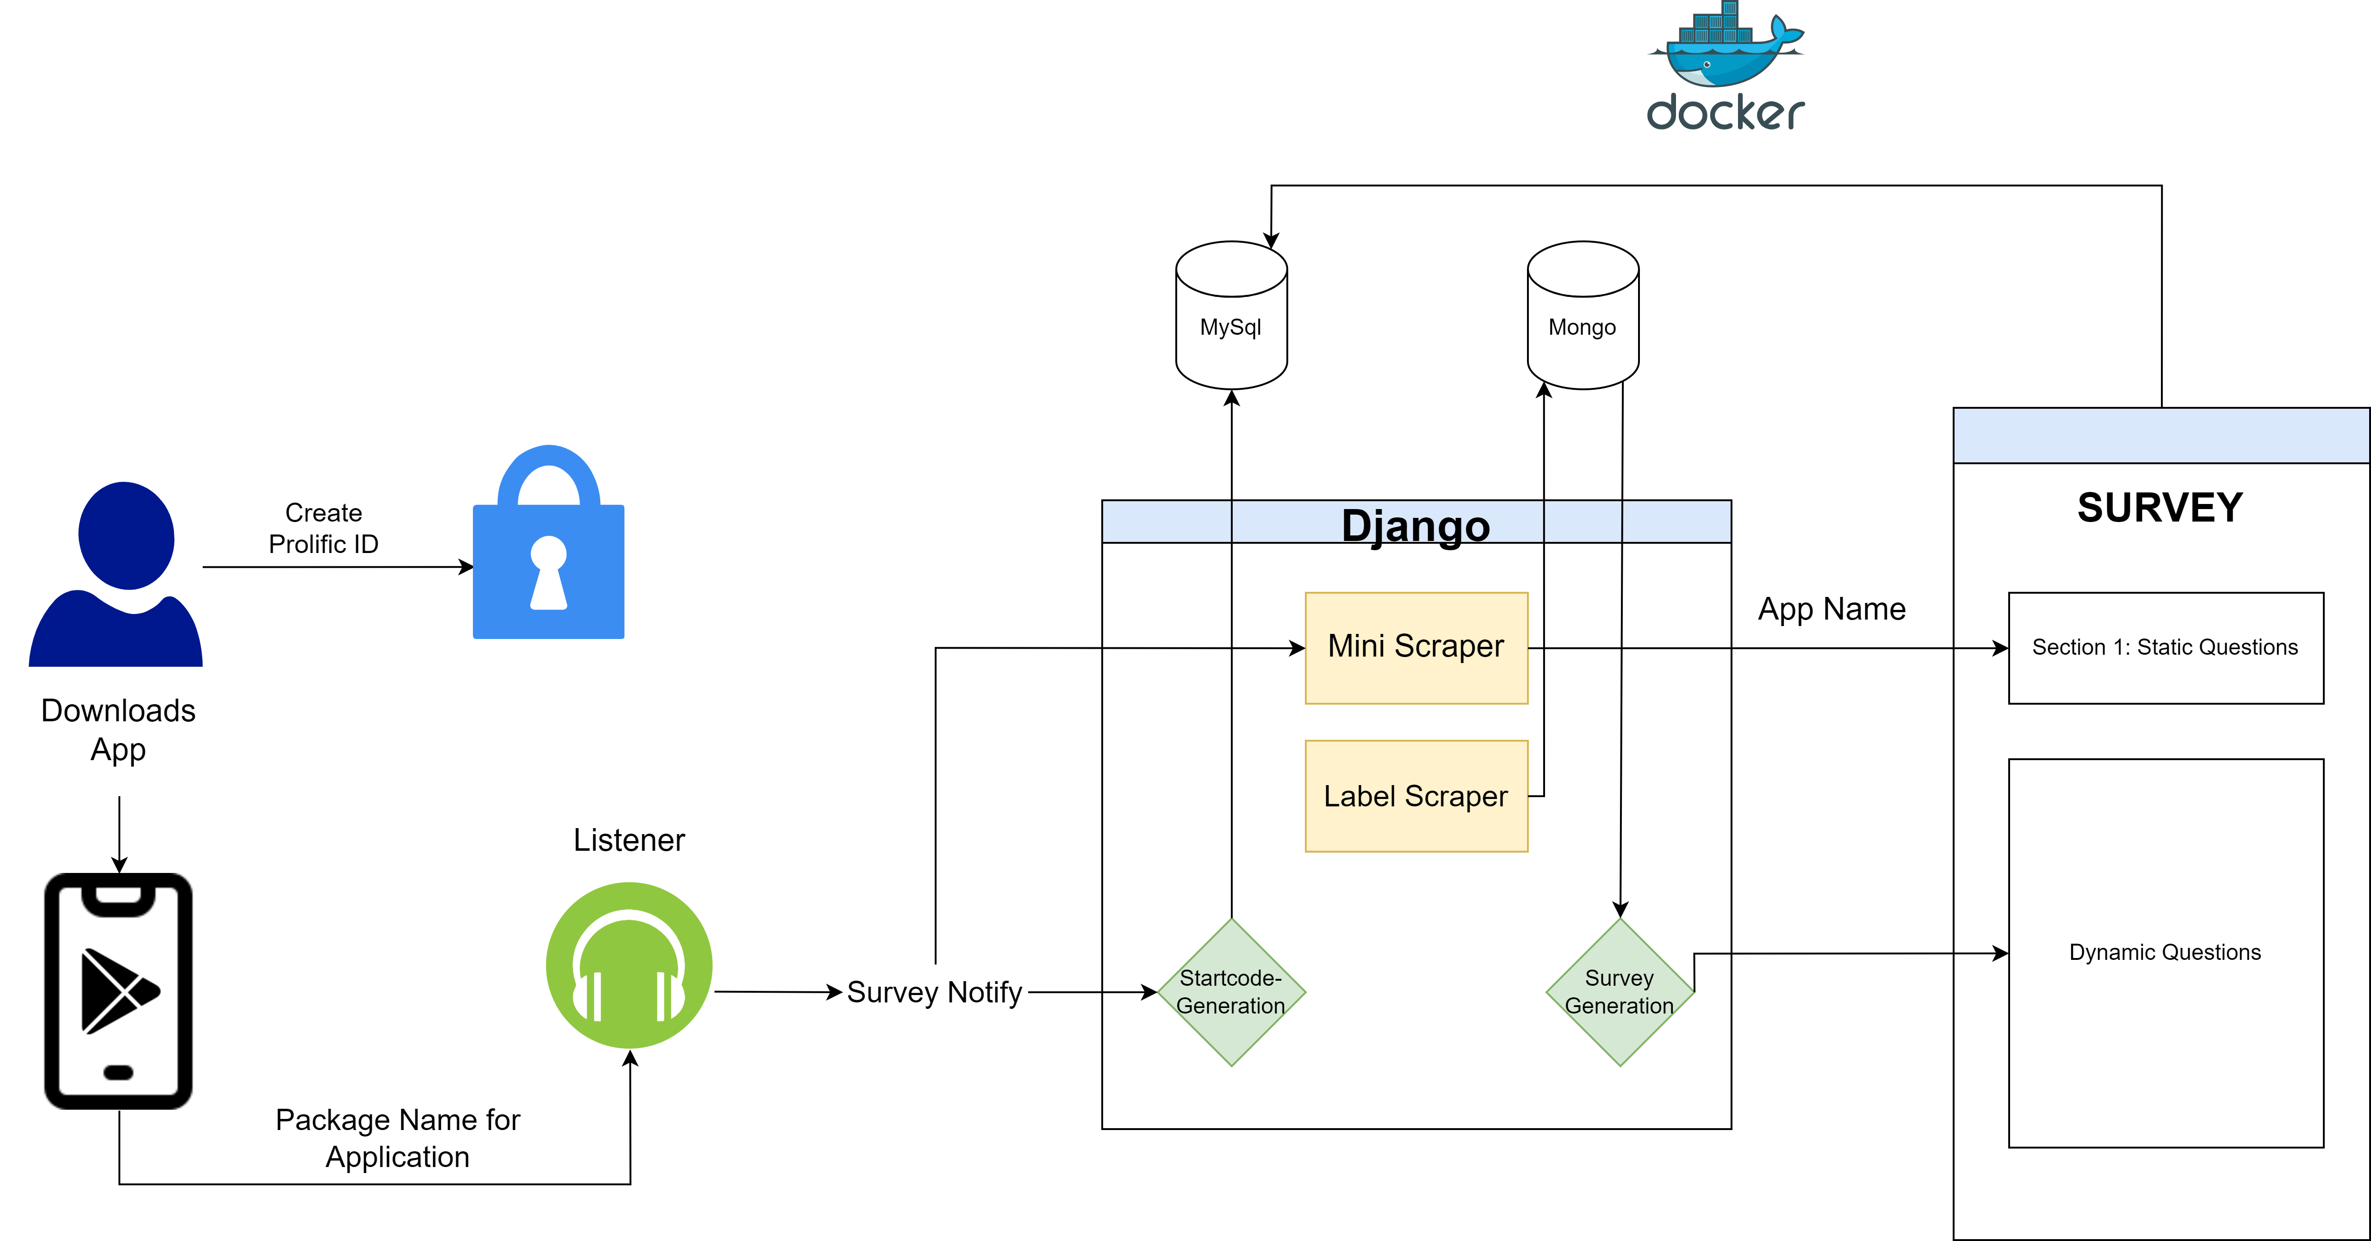


Data Safety Labels Survey Application – Proof of Concept
Elena Korkes, Victoria Hennemann, and Adam J. Aviv
What are data safety labels?
Workflow
Sample Survey Questions
Data safety labels are information provided by app developers that describe what data their app collects, how it is used, and who it is shared with.
However, data safety labels can be difficult for users to understand and find within the app or app store page.
It remains unclear how users both understand these labels and how people will effectively use labels in managing the privacy.
How concerned are you that Shareo shares adds you've seen with third-parties?
How concerned are you that Shareo collects information about your location?
System Architecture
Objectives
Future & Ongoing Work
Goal: Understand user's perceptions and understanding of data safety labels.
Product: POC application that generates app-based surveys based on apps' data safety label.
Application: Dynamic survey prompts could inform us about user's decisions once reviewing each data label information.
Research Use: Application developers can use results to determine which security measures users deem important and which they are more lenient on.
Software Advancements:
Support multiple rounds of surveying users.
Address latency concerns.
Host survey on android device
Have multiple users use the application to measure latency.
Research Goals:
A pilot study that provides feedback for the use of our applications.
Once improvements are made, conduct a pilot study that measures user's perceptions and understanding of data safety labels.
Victoria Hennemann
Email: vrhennemann@gwu.edu
Elena Korkes
Email: ekorkes@gwu.edu

